Slide 1
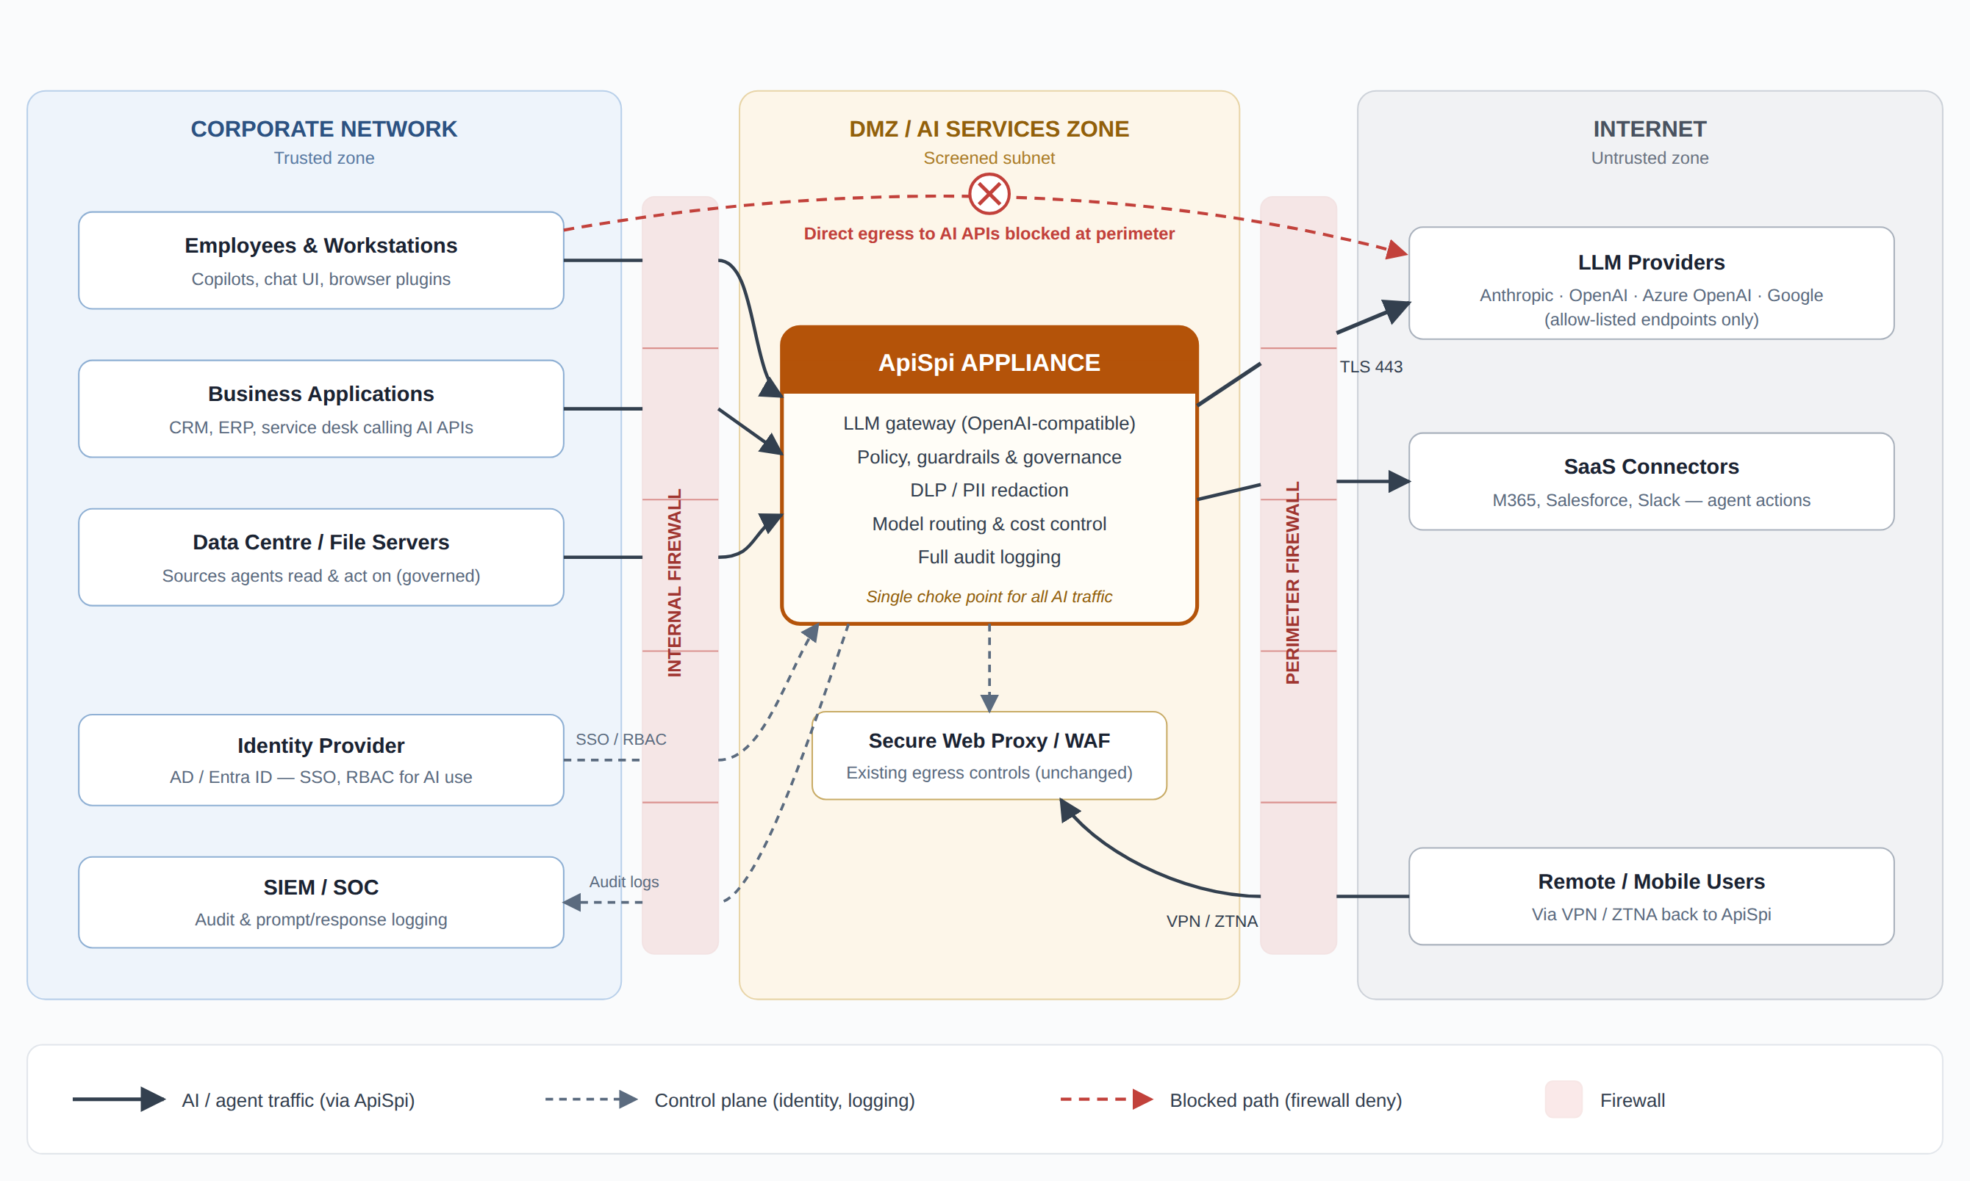
ApiSpi Appliance — Recommended Network Placement
Governed AI gateway in a DMZ / AI-services zone — the single enforced choke point for all LLM and agent traffic

Slide 2
Why This Placement
1
DMZ / screened subnet, dual-firewall
The appliance sits in its own AI-services zone. The internal firewall permits only corporate subnets to reach the gateway port; the perimeter firewall permits only the appliance to reach allow-listed AI provider endpoints on TCP 443 — and denies those destinations for everything else. ApiSpi becomes the single enforced choke point for all LLM and agent traffic.
2
Control plane stays internal
The appliance authenticates users against AD / Entra ID (SSO and RBAC decide who may use which models and agents) and streams full prompt/response audit logs to the SIEM — supporting Essential Eight, ISM and PSPF-aligned governance without exposing internal systems to the internet.
3
Remote users come back in, not around
VPN / ZTNA users reach ApiSpi the same way office users do, so policy, DLP and logging apply everywhere. Future cloud workloads should point at the same appliance (or a cloud-hosted replica) rather than calling AI providers directly.
Firewall rules in brief: inside → ApiSpi gateway port only · ApiSpi → allow-listed AI endpoints (TCP 443) only · all other egress to AI APIs denied

